Slide 1
Southern California ASHRAE – September Meeting

Slide 2
2022 Triennial Energy Code Update
Nonresidential Requirements
Bach Tsan - Building Standards Branch– Efficiency Division
Jay Madden – Southern California Edison
ASHRAE Southern California Chapter
September 13, 2022

Slide 3
Agenda
2022 Energy Code basics
Nonresidential HVAC Overview
Mechanical Mandatory Measures
Fan Power
Economizers
DOAS
Exhaust Air Heat Recovery
Ventilation Requirements
Heat Pump Baseline
Multifamily Restructuring
Resources
Notes:
Low-rise residential is single family, and multi-family buildings that are 3 stories or less;
Identify what to look for on the compliance forms and building plans during plan review
Identify which building components and forms to verify during field inspection

Slide 4
2022 Energy Code Basics

Slide 5
Authority and Process
Public Resources Code (PRC 25402): Reduction of wasteful, uneconomic, inefficient, or unnecessary consumption of energy
Warren Alquist Act Signed into law in 1974
Mandates updated Building Efficiency Standards and requires the building departments to enforce them through the permit process
Source: California Energy Commission
Notes:
Let’s start with Authority and Process
Two California assemblymen, Charles Warren and Al Alquist co-authored the Warren-Alquist Act. This Act authorizes the Energy Commission to develop the Energy Code on a triennial basis and local jurisdictions to enforce the Energy Code through the building permit process.
The Energy Code was developed, at the direction of the Warren Alquist Act, to reduce the wasteful, uneconomic, inefficient, or unnecessary consumption of energy. The Act was sign into law in 1974 by then Governor Ronald Reagan. The California Energy Commission was launched by Governor Jerry Brown in 1975 with the appointment of the first five Commissioners, and the Commission immediately set out to meet the extensive mandates of the Warren-Alquist Act, including the adoption of the first Building Energy Efficiency Standards that went into effect in 1978.

Slide 6
Goals of the California Energy Code
Increase building energy efficiency cost-effectively
Contribute to the state's GHG reduction goals
Enable pathways for all-electric buildings
Reduce residential building impacts on the electricity grid
Promote demand flexibility and self-utilization of PV generation
Provide tools for local government reach codes
Notes:
Other goals that also has been recently bestowed on us here at the Energy Commission. Through the Energy Code we need to consider reduction of Green house gasses
(Standards do consider the reduction of green house gases – GHG) AB32: reduce GHG emissions in CA to 1990 levels by 2020
SB 350: Doubling energy efficiency savings and increase CA’s renewable portfolio from 33% to 50% by 2030.
SB 100: Increase clean energy to 100% by 2045. 65% RPS by 2045 Renewable Portfolio Standards
How we are doing this is by looking into a HEAT Pump Baseline, PV and Energy Storage for self -Utilization

Slide 7
Building Standards Office
Mandates
Warren-Alquist Act
Energy Code – Develop and implement CA’s Building Energy Efficiency Standards for newly constructed buildings, additions and alterations (Title 24, Parts 6 & 11)
CBECCs – Public domain computer program, certification process, manual, sample calculations, pilot project of field testing, and model designs
Technical Assistance Program
Responsibilities
Facilitate the fair public process to update and adopt the Energy Code
Navigate rulemaking and CEQA processes in alignment with CA’s Administrative Procedures Act
Coordinate and provide education & outreach to a spectrum of stakeholders and sister agencies
Contribute to forward-planning documents related to building decarbonization

Slide 8
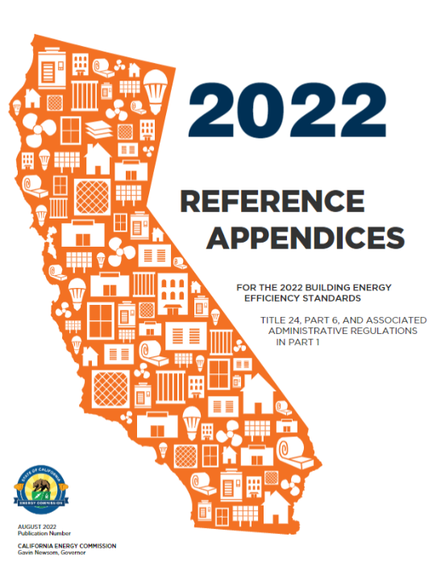
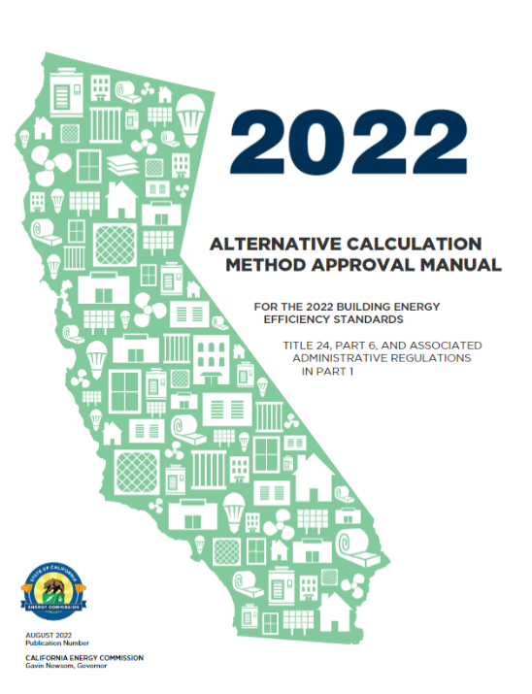
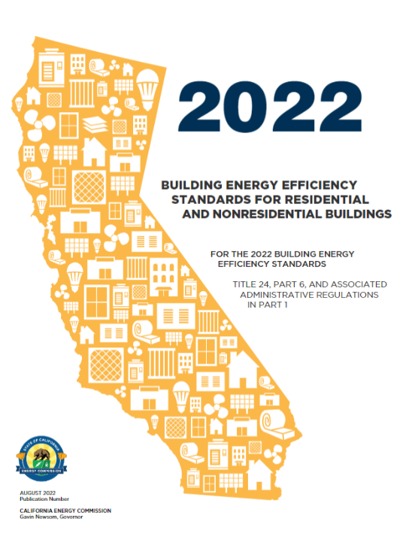
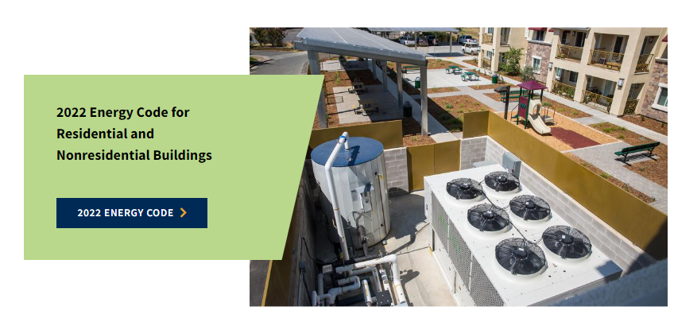
2022 Energy Code Adopted!
Adopted August 11th, 2021
Parts 1 and 6
January 1, 2023 effective date
All docs online
Final versions posted

Slide 9
Energy Code Benefits
Saves money on utility bills​
Improves consumer protection
Supports climate action​ at least-cost
Enables load flexibility and a cleaner grid​
Provides compliance flexibility
Notes:
Benefits of the Energy Code
Consumer protection mechanism
Feasible and cost-effective
Standards save >$100B on utility bills
Least-cost means for climate action
Load flexibility for a clean electrical grid
Compliance flexibility by allowing trade-offs
Sources
2019 CA Energy Efficiency Action Plan – “California has been a national leader in energy efficiency since the late 1970s, with appliance and building standards saving consumers more than $100 billion in utility bills.” file:///C:/Users/wvicent/Downloads/TN231261_20191217T104007_2019%20California%20Energy%20Efficiency%20Action%20Plan%20(1).pdf
Emission Savings from 2005, 2008, 2013, 2016, 2019 and 2022 Impact Analysis reports
Total statewide emissions from Residential and Commercial buildings: file:///C:/Users/wvicent/Downloads/TN232922_20200506T151733_Adopted%202019%20Integrated%20Energy%20Policy%20Report%20(3).pdf

Slide 10
Energy Code Environmental Benefit
Source: CEC Impact Analysis 2005, 2008, 2013, 2016, 2019, 2022
Notes:
• Roughly every three years, the CEC makes updates to the Energy Code to reduce wasteful, inefficient, uneconomic and unnecessary energy consumption in newly constructed buildings, additions and alterations.
• After the CEC adopts these standards, they are submitted to the California Building Standards Commission for approval and inclusion in the California Building Standards Code (also known as Title 24).
• The Energy Code provides substantial long-term benefits to California:
o Since the 1970’s, together the appliance and building standards have saved California consumers more than $100 billion dollars in utility bills;
o Updates to these standards are technologically feasible and cost-effective in their entirety, making the Energy Code itself a consumer protection mechanism;
o Homes and businesses are responsible for a quarter of CA’s greenhouse gas emissions. Energy Efficiency, as exemplified by the Energy Code, has been identified by the state as an essential, least-cost means to achieve CA’s climate action goals;
o The Energy Code also encourages load flexibility and responsible use of an increasingly clean electrical grid;
o And it does all of this while providing compliance flexibility by allowing for trade-offs through the performance modeling approach.
For each Energy Code update, the CEC reports estimates of statewide impacts. Looking at the greenhouse gas emissions savings from 2006 onward gives a sense of the substantial statewide environmental benefits attributed to the Energy Code.
Benefits of the Energy Code
Consumer protection mechanism
Feasible and cost-effective
Standards save >$100B on utility bills
Least-cost means for climate action
Load flexibility for a clean electrical grid
Compliance flexibility by allowing trade-offs
Sources
2019 CA Energy Efficiency Action Plan – “California has been a national leader in energy efficiency since the late 1970s, with appliance and building standards saving consumers more than $100 billion in utility bills.” file:///C:/Users/wvicent/Downloads/TN231261_20191217T104007_2019%20California%20Energy%20Efficiency%20Action%20Plan%20(1).pdf
Emission Savings from 2005, 2008, 2013, 2016, 2019 and 2022 Impact Analysis reports
Total statewide emissions from Residential and Commercial buildings: file:///C:/Users/wvicent/Downloads/TN232922_20200506T151733_Adopted%202019%20Integrated%20Energy%20Policy%20Report%20(3).pdf

Slide 11
Nonresidential Mechanical Updates
Review what’s new in 2022 Energy Code for:
Mechanical Mandatory Measures
HVAC Selections
Ventilation Requirements
Fan Power
Economizers
Boilers
Dedicated Outdoor Air Systems (DOAS)
Exhaust Air Heat Recovery
Domestic Hot Water
Alterations

Slide 12
HVAC Selections
SECTION 140.4 (a) 2 – PRESCRIPTIVE REQUIREMENTS FOR SPACE CONDITIONING SYSTEMS SINGLE ZONE SYSTEMS
Allowed Prescriptively:
(Single zone systems with direct expansion cooling ≤ 240,000 Btu/hr)
School Building Spaces
Climate Zones 2-15: Heat Pump
Climate Zones 1, 16: Dual-fuel Heat Pump
Retail and Grocery Building Spaces
Climate Zones 2-15: Heat Pump
Climate Zones 1, 16:
Cooling capacity < 65,000 Btu/hr: Furnace A/C
Cooling capacity ≥ 65,000 Btu/hr: Dual-fuel Heat Pump
Office, Financial Institution and Library Building Spaces
Climate Zones 1-15: Heat Pump
Climate Zone 16:
Cooling capacity < 65,000 Btu/hr: Furnace A/C
Cooling capacity ≥ 65,000 Btu/hr: Dual-fuel Heat Pump
Office Spaces in Warehouses
Climate Zones 1-16: Heat Pump
Notes:
Heat pump baseline for certain spaces

Slide 13
Heat Pumps
Electric water and space heating
Increases efficiency
Reduces GHGs
Encourages load flexibility
2022 Energy Code
Multifamily: space heating standard
Commercial: Prescribed for schools, offices, banks, libraries, retail, grocery in Climate Zones 2 -15
Notes:
*Heat pump exceptions to the above include:
Low-Rise MF for CZ16 – Standard is A/C w/ Furnace
High-Rise MF for CZ1 & CZ16 – Standard is Dual-Fuel Heap Pump
Schools for CZ 2-15 – Standard is both HPWH + HPSH, schools less than 4-stories and less than 25,000SF

Slide 14
HVAC Efficiency Mandatory Requirements
All Buildings § 110.2
TABLE 110.2-B HEAT PUMPS, MINIMUM EFFICIENCY REQUIREMENTS
Equipment Type | Size Category | Rating Condition | Efficiency ª | Test Procedure ^{b}
Air Cooled | ≥ 65,000 Btu/h and |  | 11.0 EER | AHRI 340/360
(Cooling Mode), both split | < 135,000 Btu/h |  | 14.1 IEER
system and single
package
Air Cooled | ≥ 135,000 Btu/h and |  | 10.6 EER | AHRI 340/360
(Cooling Mode), both split | < 240,000 Btu/h |  | 13.5 IEER
system and single
package
Air Cooled | ≥ 240,000 Btu/h |  | 9.5 EER | AHRI 340/360
(Cooling Mode), both split |  |  | 12.5 IEER
system and single
package
Water source (cooling mode) | ≥ 65,000 Btu/h and < 135,000 Btu/h | 86ºF entering water | 13.0 EER | ISO-13256-1
Groundwater source (cooling mode) | < 135,000 Btu/h | 59ºF entering water | 18.0 EER | ISO-13256-1
Ground source (cooling mode) | < 135,000 Btu/h | 77ºF entering water | 14.1 EER | ISO-13256-1
Water source water-to- water (cooling mode) | < 135,000 Btu/h | 86ºF entering water | 10.6 EER | ISO-13256-2
Groundwater source water-to-water (cooling mode) | < 135,000 Btu/h | 59ºF entering water | 16.3 EER | ISO-13256-21
Minimum efficiency increased
Various cooling systems
Cooling towers
Furnaces
Boilers
New tables added
Heat pumps
DOAS
Computer room units
Heat Recovery chillers
Notes:
Go to 15-Day Language document to see what was added or changed.

Slide 15
Ventilation Requirements
Mandatory requirements (§120.1(c)3; §120.1(f)):
Ventilation rate based on Equation 120.1-F only
Alternate method based on number of occupants limited to spaces with fixed seating or subject to CA Building Code §1004.5
Design and Control Requirements for Quantities of Outdoor Air:
Variable Air Volume (VAV) systems to be capable of maintaining measured outside air rates within 10% of designed minimum
All mechanical ventilation and space conditioning systems are to be tested to confirm they operate within 10% of the designed minimum outside air rate
Note testing requirement for all systems, not just constant volume as was required in 2019
Notes:
Tested to confirm ability to be in 10%

Slide 16
Economizer
SECTION 140.4 (e) – PRESCRIPTIVE REQUIREMENTS FOR ECONOMIZERS
Economizer Changes:
Expanded airside economizer requirements
Prescriptively required when the air handler has cooling capacity > 33,000 Btu/hr
Smaller rooftop units
Smaller split DX air handlers
VRFs and mini-splits
Air Economizer Controls: New Construction Inspection and Functional Testing to verify presence of economizer bypass controls for systems with heat recovery ventilators has been field or factory calibrated.
New economizer exceptions:
Exception for certain dedicated outside air systems configurations
Each air handler that has a design cooling capacity
< 54,000 Btu/hr and ventilation provided by a
dedicated outdoor air system (DOAS) with exhaust air heat recovery
The DOAS unit shall meet the exhaust air heat recovery ratio as specified in §140.4(q)1 and includes bypass or control to disable energy recovery as specified in §140.4(q)2
The DOAS unit shall provide at least the minimum ventilation air flow rate as specified in
§120.1(c)3 and provide no less than 0.3 cfm/ft2 during economizer conditions
Exception for controlled environment horticulture using carbon enrichment
Notes:
Section: NA 7.5.4 – ECONOMIZER CONTROLS AND EXHAUST AIR HEAT RECOVERY

Slide 17
Dedicated Outdoor Air Systems
New Section:140.4(p)–PRESCRIPTIVE REQUIREMENTS FOR SPACE-CONDITIONG SYSTEMS
DOAS supply air shall be delivered directly to the occupied space or at the outlet of any terminal heating/cooling coils and cycle off any fans, pumps, and terminal unit fans when there is not call for heating/cooling
Prescriptive Requirements for DOAS Design:
DOAS Unit Fan Systems:
If input power < 1 kW, shall not exceed a total combined fan power of 1.0 W/cfm
If input power ≥ 1 kW, shall meet the requirements of §140.4(c)
Supply Air:
Shall be delivered directly to the occupied space or at the outlet of any terminal heating or cooling coils
Shall cycle off any zone heating and cooling equipment fans, circulation pumps and terminal unit fans when there is no call for heating or cooling in the zone

Slide 18
Dedicated Outdoor Air Systems
Prescriptive Requirements for DOAS Design:
Supply and Exhaust Fans:
Minimum of three speeds to facilitate system balancing
DOAS with mechanical cooling providing ventilation to multiple zones and operating in conjunction with zone heating and cooling systems:
Shall not use heating or heat recovery to warm supply air above 60°F when representative building loads or outdoor air temperature indicate that the majority of zones require cooling
Exceptions to §140.4(p)2 (Supply Air):
Active chilled beam systems
Sensible-only cooling terminal units with pressure-independent variable-airflow regulating devices limiting the DOAS supply air to the greater of latent load or minimum ventilation requirements
Any configuration where a DOAS unit provides ventilation air to a downstream fan (a terminal box, air handling unit or other space conditioning equipment) where the total system airflow can be reduced to ventilation minimum or the downstream fan power is no greater than 0.12 watts per cfm when space temperatures are within the thermostat dead band (at low speed per manufacturer literature)

Slide 19
REQUIREMENTS FOR EXHAUST AIR HEAT RECOVERY
SECTION 140.4 (q) – Prescriptive Requirements for Exhaust Air Heat Recovery
Prescriptive requirement is listed in Table 140.4-J or Table 140.4-K, which is informed by:
Climate zone
Percent outdoor air at full design airflow
Number of hours/year
Partial tables listed here for demonstration purposes (values shown in cfm)
Prescriptive Design Criteria
Either:
Sensible energy recovery ratio of at least 60% OR
Enthalpy recovery ratio of at least 50% for both heating and cooling design conditions, and be rated in accordance with AHRI 1060
Energy recovery bypass or control to:
Disable energy recovery AND
Directly economize with ventilation air based on outdoor air temperature limits specified in Table 140.4-G
For energy recovery systems where the transfer of energy cannot be stopped:
Bypass shall prevent the total airflow rate of either outdoor air or exhaust air through the energy recovery exchanger from exceeding 10% of the full design airflow rate
Excerpt of Table 140.4-J: Energy Recovery Requirements by Climate Zone and
Percent Outdoor Air at Full Design Airflow (< 8,000 Hours / Year)
% Outdoor Air at Full Design Airflow | Climate Zone
 | 1 | 2 | 3 | 4 | 5 | 6 | 7 | 8 | 9 | 10 | 11 12 13 14 15 16
≥ 10% and < 20% | NR | NR | NR | NR | NR | NR | NR | NR | NR | NR | NR NR NR NR NR NR
≥ 20% and < 30% | ≥ 15,000 | ≥ 20,000 | NR | NR | NR | NR | NR | NR | NR | NR | ≥ 18,500 ≥ 18,500 ≥ 18,500 ≥ 18,500 ≥ 18,500 ≥ 18,500
Excerpt of Table 140.4-K: Energy Recovery Requirements by Climate Zone and
Percent Outdoor Air at Full Design Airflow (≥ 8,000 Hours / Year)
% Outdoor Air at Full Design Airflow | Climate Zone
 | 1 | 2 | 3 | 4 | 5 | 6 | 7 | 8 | 9 | 10 11 12 13 14 15 16
≥ 10% and < 20% | ≥ 10,000 | ≥ 10,000 | NR | NR | NR | NR | NR | NR | NR | ≥ 40,000 ≥ 40,000 ≥ 20,000 ≥ 10,000 ≥ 10,000 ≥ 10,000 ≥ 10,000
≥ 20% and < 30% | ≥ 2,000 | ≥ 5,000 | ≥ 13,000 | ≥ 9,000 | ≥ 9,000 | NR | NR | NR | NR | ≥ 15,000 ≥ 15,000 ≥ 5,000 ≥ 5,000 ≥ 5,000 ≥ 5,000 ≥ 5,000
Notes:
Section: 140.4(q)– PRESCRIPTIVE
New section for Exhaust Air Heat Recovery
Look up tables added to determine if requirements are applicable
Similar requirements to ASHRAE 90.1
Energy recovery ratio requirements
Energy recovery bypass or control to disable energy recovery to directly economize
Exception for DOAS capable of shutting off when a space conditioning system meets economizer requirements
Applies to non-critical healthcare facilities

Slide 20
REQUIREMENTS FOR EXHAUST AIR HEAT RECOVERY
Exceptions
Systems meeting §140.9(c) Prescriptive Requirements for Laboratory and Factory Exhaust Systems
Systems serving spaces that are not cooled and that are heated to < 60°F
Systems expected to operate less than 20 hours per week
Climate Zone 1:
Exempt from sensible recovery ratio requirements at cooling design conditions
Climate Zone 15:
Exempt from sensible recovery ratio requirements at heating design conditions
Climate Zone 16:
Exempt when > 60% of the outdoor air heating energy is provided from site-recovered energy
Where the sum of the airflow rates exhausted and relieved within 20 feet of each other is < 75% of the design outdoor airflow rate, excluding exhaust air that is either:
Used for another energy recovery system OR
Not allowed by California Mechanical Code (Title 24, Part 4) for use in energy recovery systems with leakage potential OR
Of Class 4 as specified in Energy Code §120.1(g)
Economizer exception for air handlers less than 54kBTUh which utilizes a dedicated outdoor air system (DOAS) in accordance with 140.4(p)1B and 140.4(p)2, and include:
Exhaust Air Heat Recovery Ratio specified in 140.4(q)1 and bypass or controls to disable energy recovery in 140.4(q)2
Provide at least minimum ventilation airflow specified in 120.1(c)3 and provide no less than 0.3cfm/ft2
Notes:
Section: 140.4(q)– PRESCRIPTIVE
Exceptions
Lab and Factory Exhaust systems in Covered Processes
Spaces that are not cooled and heated to < 60degF
Where 60 percent of outdoor air is provided from site-recovered energy in CZ 16
Sensible recovery ratio at heating design conditions for CZ 15 and CZ 1
Exhaust airflow rates <75% of design OA rate used for another energy recovery system, or not allowed by CMC, or class 4 air.
Systems that operate less than 20 hrs / week

Slide 21
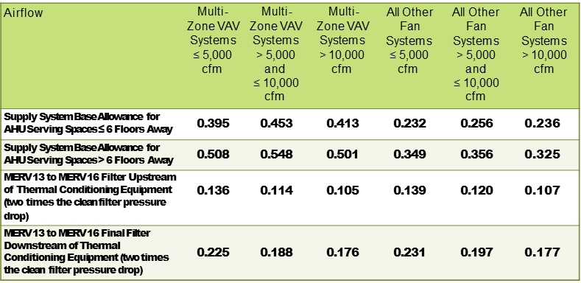
Fan Power Budget
SECTION 140.4 (c) – Prescriptive Requirements for Fan Systems
Section 140.4 – HVAC
Replacing Fan Power Limits with Fan Power Budget
Fan systems with at least one fan or fan array with fan electrical input power ≥ 1 kW
Splitting power allowances for supply and return side
Multizone VAV definition
Includes healthcare facilities
Air density and partial airflow adjustments
Significant updates to fan power budget
Fan power calculations revised
Fan power allowance dependent on system type
Each fan component gets an allowance; allowances vary by system type, CFM and floors served
For elevations > 3,000 feet, multiply fan budget by Correction Factor listed in Table 140.4-C
Excerpt of Table 140.4-A: Supply Fan Power Allowances (Watts/cfm)

Slide 22
Fan Power Table 140.4 (a)
2019
2022

Slide 23
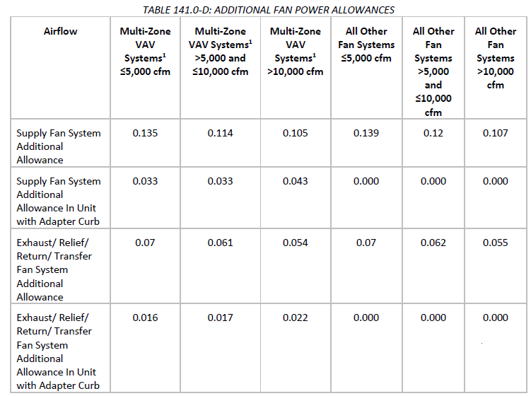
Fan Power Budget for HVAC Alterations
New/Replacement HVAC System
Additional Fan Power Allowances are available as specified in Table 141.0-D
These values can be added to the Fan Power Allowance values in Table 140.4-A and Table 140.4-B

Slide 24
Fan Energy Index
Section:120.10–MANDATORY REQUIREMENTS FOR FANS
Fan Energy Index (FEI) of 1.0 or greater required for:
Each fan or fan array with a combined motor nameplate > 1.0 hp, or
Each fan or fan array with combined fan nameplate electrical input power > 0.89 kW
Variable Air Volume shall have FEI ≥ 0.95
Fan arrays shall be calculated in accordance with ANSI/AMCA 208-18 Annex C.
All FEI values shall be provided by the manufacturer and third party verified.
Exemptions
FEI values for embedded fans do not need to be third party verified.
Embedded fans that are listed under Section 110.2, Section 110.1, or equipment that has an efficiency standard under 10 CFR 431 that takes effect prior to January 1, 2026.
Embedded fans and fan arrays with a combined motor nameplate horsepower ≤ 5 hp or with a fan system electrical input power of ≤ 4.1 kW.
Circulation fans, ceiling fans, and air curtains.
Fans intended to only operate during emergency conditions.
Notes:
Section:120.10–MANDATORY REQUIREMENTS FOR FANS
Fan Energy Index

Slide 25
Duct Leakage and Testing
Section:120.4–MANDATORY REQUIREMENTS FOR DUCT AND PLENUM MATERIALS
Prescriptive Section 140.4(l) is now mandatory in 120.4(g).
New duct systems meeting criteria below shall be HERS tested to verify no more than 6% leakage:
Provides conditioned air to an occupiable space for a constant volume, single zone space-conditioning system, AND
Serves < 5,000 ft² of CFA, AND
Have more than 25% of duct in unconditioned space or outdoors
New: All ductwork to meet Seal Class A to align with ASHRAE 90.1
Exemptions:
Healthcare facilities
New duct systems that are not subject to testing under §120.4(g)1 shall instead meet the duct leakage testing requirements of CA Mechanical Code §603.10.1
Notes:
-Seal Class A – everything must be sealed, joints, seams, duct wall penetrations.
-Duct sealing section 140.4(l) is now mandatory in 120.4(g)
- not healthcare, duct provides conditioned air, space conditioning systems serves <5k sq ft, surface area of ducts outdoors or in unconditioned space combined is >25% of the surface area of total system
- ducts that do not follow this, will be tested by CMC 603.10.1 (SMACNA duct leakage testing)

Slide 26
Boilers
Section:140.4(k)8
New Prescriptive requirements apply to:
Space heating gas boiler systems with total input 1,000,000 – 10,000,000 Btu/hr
Boilers < 300,000 Btu/hr not included in the total system input
Hot Water Distribution Design:
Climate Zones 1-6, 9-14, 16:
90% minimum efficiency
Coils and other heat exchangers designed for hot water return temperature of 120°F or less
The flow rate of hot water that recirculates is reduced to ≤ 20% of the design flow of the operating boilers
Notes:
140.4(k)8
Condensing gas water heater needs the inlet water temperature at a certain range to operate optimally. If the incoming water is too hot, it might be outside the condensing range and you lose a lot of the efficiency. The requirement is to ensure the system operates optimally, therefore the 120F limit and the 20%. This requirement is taken almost verbatim from 90.1.

Slide 27
Federal Equipment Ratings
Currently SEER, HSPF and EER
Federal and CA T24 Part 6 : January 1, 2023 (or earlier depending on manufacturer inventory) SEER2. HSPF2, EER2
Compliance tables in development

Slide 28
Covered Process
Computer Room ACs
Transcritical CO2
Compressed Air
Steam Traps
Grow Facilities
New requirements added for transcritical CO₂ gas coolers for refrigerated warehouses and commercial refrigeration
Prohibited in some climate zones
New requirements added for compressed air systems
Monitoring
Pipe leak testing
Pipe sizing
New requirements for steam traps

Slide 29
Computer Room Efficiency
Section:120.6(j) - Mandatory Requirements for Computer Rooms
Computer room efficiency measures include revisions to existing mandatory requirements and new mandatory requirements.
Reheat controls preventing reheating, re-cooling and simultaneous heating and cooling
Humidification shall be adiabatic
Variable fan controls when mechanical cooling capacity > 60,000 Btu/hr

Slide 30
Computer Room Efficiency
Section:140.9(a) - Prescriptive Requirements for Computer Rooms
Section:141.1(b) - Requirements for Alterations to Computer Rooms
Table 140.9-A: Minimum Pumped Refrigerant Economizer CRAC Net Sensible COP by Climate Zone
Prescriptive:
Changes to Prescriptive Requirements for Computer Rooms:
New language added allowing for Refrigerant Economizers
Other language changes affecting unit selections
Clim ate | Zone | Net Sensible COP
1 | 5.5
2 | 4.5
3 | 4.2
4 | 3.8
5 | 4.3
6 | 2.7
7 | 2.3
8 | 2.8
9 | 3.3
10 | 3.4
11 | 3.9
12 | 4.0
13 | 3.7
14 | 3.7
15 | 3.6
16 | 3.0
Notes:
§140.9(a)
Prescriptive Requirements for Computer Rooms. Computer rooms with a power density greater than 20 W/ft2 shall comply with this section.
1. Economizers. Each individual cooling system primarily serving computer rooms shall include either:
A. An integrated air economizer capable of providing partial cooling even when additional mechanical cooling is required and capable of providing 100 percent of the expected system cooling load at 65°F to 80.6°F supply air temperature at outside air temperatures of 65°F dry-bulb and below or 50°F wet-bulb and below, and be equipped with a fault detection and diagnostic system as specified by Section 120.2(i); or
B. An integrated water economizer capable of providing partial cooling even when additional mechanical cooling is required and capable of providing 100 percent of the expected system cooling load at 65°F to 80.6°F supply air temperature at outside air temperatures of 50°F dry-bulb and below or 45°F wet-bulb and below.
EXCEPTION 1 to Section 140.9(a)1: Individual computer rooms with an ITE design load under 5 tons (18 kW) in a building that does not have any economizers.
EXCEPTION 2 to Section 140.9(a)1: A computer room with an ITE design load less than 20 tons (70 kW) may be served by a second fan system without an economizer if it is also served by a fan system with an economizer that also serves other spaces within the building, provided that all of the following are met:
i. The economizer system is sized to meet the design cooling load of the computer room when the other spaces within the building are at 50 percent of their design load at outside air temperatures of 65°F dry-bulb and below or 50°F wet-bulb and below; and
ii. The economizer system has the ability to serve only the computer rooms connected to it, e.g., shut off flow to other spaces within the building when unoccupied.
An integrated air economizer capable of partial cooling when additional mechanical cooling is required and capable of providing 100 percent of the expected system cooling load up to 80°F room supply air temperature at outside air temperatures of 55°F dry-bulb and below or 50°F wet-bulb and below, and be equipped with a fault detection and diagnostic system as specified by section 120.2(i); or
B. An integrated water economizer capable of partial cooling when additional mechanical cooling is required and capable of providing 100 percent of the expected system cooling load up to 80°F room supply air temperature at outside air temperatures of 40°F dry-bulb and below or 35°F wet-bulb and below.

Slide 31
Refrigeration (Warehouse and Commercial)
Section:120.6( (a) Mandatory Requirements for Refrigerated Warehouses; (b)Mandatory Requirements for Commercial Refrigeration.
Mandatory requirements:
Compressor design requirements
Transcritical CO2 fan powered gas cooler requirements
Not allowed in Climate Zones 9-15
for Refrigerated Warehouses
Not allowed in Climate Zones 10-15 for Commercial Refrigeration
Many other design criteria
Automatic door closer requirements for Refrigerated Warehouses
Notes:
§120.6(a-b)

Slide 32
Growing Facilities
Section:120.6(h) - Mandatory Requirements for Controlled Environmental Horticulture
New requirements/clarifications for controlled environmental horticulture
Dehumidification
Photosynthetic photon efficacy requirements (PPE) for lighting
Indoor growing and greenhouses
Envelope requirements for conditioned greenhouses
Electrical power distribution to measure lighting load
Notes:
§120.6(h)

Slide 33
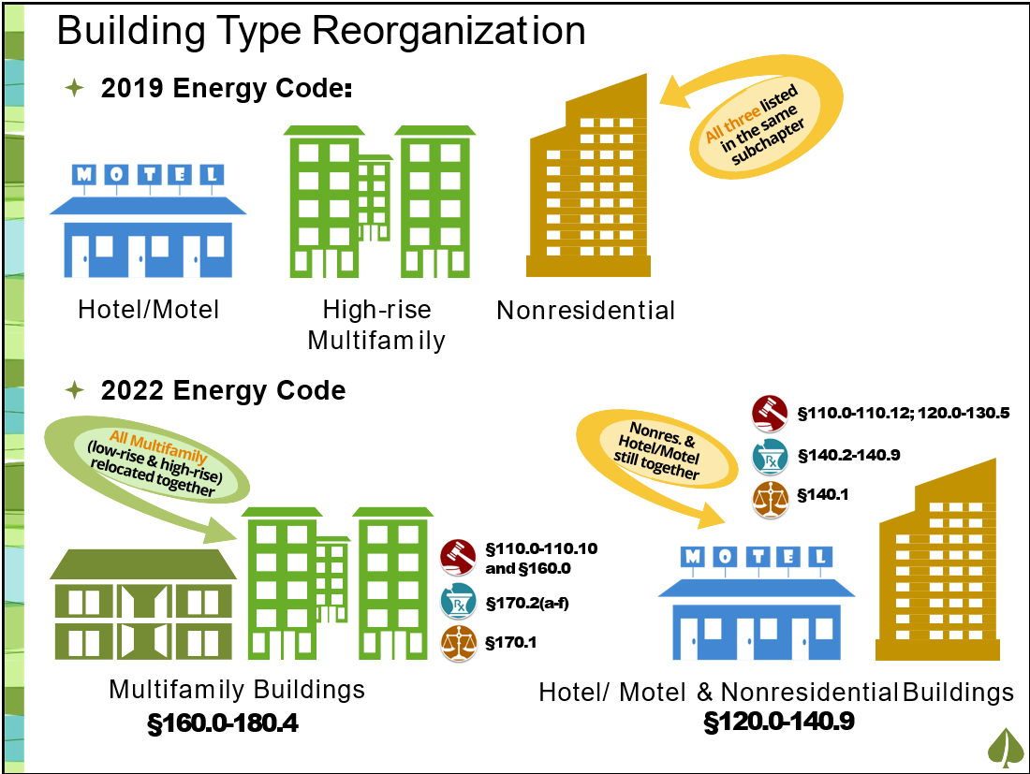
Multifamily Restructuring
Consolidates multifamily provisions into dedicated chapters
Heat pump baseline, electric ready requirements for dwellings
PV and battery storage dependent on number of habitable stories
Notes:
The 2022 Building Energy Efficiency Standards for multifamily buildings consolidate requirements for all multifamily building types, with requirements based on assembly or fenestration type rather than number of stories. This reclassification allows for better
alignment of energy efficiency requirements with fire safety and structural requirements. Differences from the 2019 requirements depend both on the assembly or fenestration type and whether the building is three or fewer, or four or more stories. Table 170.2-A of the Standards captures the updated requirements for all multifamily buildings.
Notable 2022 envelope changes include:
Buildings up to three habitable stories have a new prescriptive insulation Option D for roof assemblies without attics.
Buildings with four stories or more with attics have new prescriptive Options B or C for roof and ceiling insulation.
Prescriptive roof reflectance and emissivity requirements depend on roof options Option B, C, or D
Prescriptive reflectance requirements increased to 0.63 in CZs 9-11 and 13-15 for buildings with low-sloped roofs and no attic.
Mandatory and prescriptive wall U-factors are recategorized by assembly type and by fire rating for framed assemblies. This results in many climate zone specific adjustments. The greatest changes include reduced U-factors for framed walls in multifamily buildings with four or more stories.
New construction prescriptive fenestration properties, including U-factor, solar heat gain coefficient (SHGC), and Visual Transmittance (VT), depend on categorization into curtainwall, Class AW, or “all other fenestration”, and vary by climate zone. There is no distinction between fixed and operable windows. The greatest change is for fenestration in multifamily buildings with four or more stories that fall into the “all other fenestration” category (not curtainwall or Class AW).
Prescriptive requirements for fenestration properties in multifamily building additions and alterations depend on window classification (curtainwall, Class AW, or all other).
Prescriptive fenestration area is limited to both 40 percent window-to-wall ratio and 20 percent window-to-floor ratio.

Slide 34
Software : CBECC for Compliance

Slide 35
Software Feature Updates
The 2022 compliance software has been named CBECC.
It now integrates both nonresidential (commercial) and multifamily residential (low-rise and high-rise) modeling capabilities combining both the simulation engines,
EnergyPlus(v9.4) from CBECC-Com : Typical Capabilities as previous software versions.
California Simulation Engine (CSE) from CBECC-Res.
The California Simulation Engine (CSE) is used to model residential zone groups and related objects. This brings modeling capabilities such as pressure-based airflow modeling to capture stack effect and interactions between infiltration and mechanical systems

Slide 36
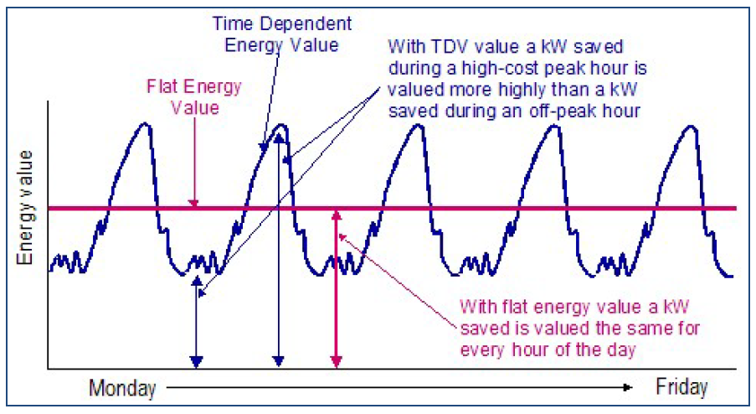
Software Feature Updates(cont.)
Determination of building compliance is now based on three separate metrics (Efficiency and Total Compliance TDV and Total Compliance Source Energy)
For a proposed building to comply, both its TDV and HSE energy use must be less than or equal to the standard design energy budgets
HSE is an energy metric for electricity, natural gas , and propane.
Other dialog tabs provide model and end use results for site & source energy, TDV, and CO2 emissions.
Notes:
As the name implies, the TDV metric values energy differently depending on the day of the year and hour of the day that a specific type of energy is used. This means that electricity saved on a hot summer afternoon will be worth more in the compliance process than the same amount of electricity saved earlier in the morning when temperatures are mild, HVAC loads are lower, and electricity grid demand for energy is lower. The value assigned to energy savings through TDV more closely reflects the long-term costs for electricity, natural gas, and propane and provides compliance credit for measures that results in load shifting from peak periods to off-peak periods.
This means that energy savings during the night, when solar generation is low, is more valuable in HSE than savings during the morning when solar generation is greater .
I think this sentence is quite true for solar but is less true for wind. Wind resources at night can be good. Might just make this sentence about solar.

Slide 37
Software Feature Updates(cont.)
Standard design HVAC system mapping updated to reflect 2022 changes, including building specific systems and use of single-zone heat pumps (all-electric or dual fuel, depending on climate zone).
Standard design fan power and fan power credits updated to utilize new W/cfm allowances based on system capacity.
Expand standard design economizer requirements to systems >33 kBtu/hr, and revise to use fixed dry bulb temperature control limit based on climate zone.
Revise standard design ‘Computer Room’ system air flows sizing to meet 100% of cooling load when outdoor air dry-bulb temperature 65oF and below.
Heat recovery is modeled in standard design systems based on climate zone and outside air ratios. Heat recovery is now allowed to be modeled for all systems, even if not 100% outside air.
Revise minimum air flow rate (i.e. deadband flow) of standard design VAV systems with DDC to be minimum ventilation rate.

Slide 38
Software Feature Updates(cont.)
Multifamily Incorporation
Common areas (E+)
Dwellings (CSE)
Copy inputs from CBECC-RES to CBECC
Notes:
As the name implies, the TDV metric values energy differently depending on the day of the year and hour of the day that a specific type of energy is used. This means that electricity saved on a hot summer afternoon will be worth more in the compliance process than the same amount of electricity saved earlier in the morning when temperatures are mild, HVAC loads are lower, and electricity grid demand for energy is lower. The value assigned to energy savings through TDV more closely reflects the long-term costs for electricity, natural gas, and propane and provides compliance credit for measures that results in load shifting from peak periods to off-peak periods.
This means that energy savings during the night, when solar generation is low, is more valuable in HSE than savings during the morning when solar generation is greater .
Put simply, HSE represents the amount of long-term depletable energy resources used to meet the energy demand of the building in each hour.

Slide 39
Software Links
2022 Software CEC webpage (links to software and dockets):
https://www.energy.ca.gov/programs-and-topics/programs/building-energy-efficiency-standards/2022-building-energy-efficiency-1
Location of MF Restructured Demo Video (NORESCO Site)
https://bees.noresco.com/software2022.html
Subscribe to the Building Standards subscription topic so they get software notices:
https://www.energy.ca.gov/subscriptions

Slide 40
Resources

Slide 41
2022 Energy Code Links
2022 initiatives CASE reports: California Energy Codes & Standards website at https://title24stakeholders.com/
2022 Energy Code updates: CEC 2022 Energy Code webpage at https://www.energy.ca.gov/programs-and-topics/programs/building-energy-efficiency-standards/2022-building-energy-efficiency
Make comments: CEC docket 21-BSTD-04 at https://efiling.energy.ca.gov/Ecomment/Ecomment.aspx?docketnumber=21-BSTD-04

Slide 42
Online Resource Center
Notes:
In process of updating resources for the 2019 Energy Code
Updated fact sheets, presentations, etc. will be posted on ORC at this link.
Working with ICC to develop Significant Changes Guidebook for the 2019 Energy Code.

Slide 43
Blueprint Newsletter
Notes:
How many receive this newsletter? How many read it?
Strongly recommend reading this newsletter
Demo complied version and do search for all Blueprints when they have a question

Slide 44
Stay Connected
Receive Energy Code updates
Subscribe to Efficiency Division emails at https://ww2.energy.ca.gov/listservers/index_cms.html
Appliances
Blueprint
Building Standards
Respond to confirmation email
Follow the California Energy Commission
Notes:
Best way to receive updates and keep up to speed with the Energy Code.
Notifications when ORC is updated, new provider is approved, 2019 workshops, etc.
Leave a business card, we can sign you up.
Follow CEC on any of these social media platforms

Slide 45
Upcoming CALBEM Workshops
Source: https://calbem.ibpsa.us/
Notes:
CalBEM convenes representative voices in the building energy modeling (BEM) field to identify and collaborate on BEM improvements related to energy codes and building performance. They meet throughout the year via Working Groups and at an annual event. CalBEM is sponsored by Southern California Edison on behalf of California utilities.

Slide 46
Energy Code Ace
Forms and resource tools
Free training in-person and online
Checklists and trigger sheets for building departments
Notes:
2019 forms are here
Have a forms tool that list all forms required for a project (res or nonres; new or altered) from permit to final inspection. Some building departments require applicants to use this tool and provide the forms report to obtain a permit.
Resource tool is very useful! All Standards documents are complied into one, and it allows you to do a word search for all documents at once.
Free training. They will come to you if you can get enough people. Have self-taught course online as well. AND, they are an ICC Preferred Provider and can obtain CEUs.
Checklists, Trigger Sheets, etc. made especially for them (enforcement agencies) to help simplify the code.

Slide 47
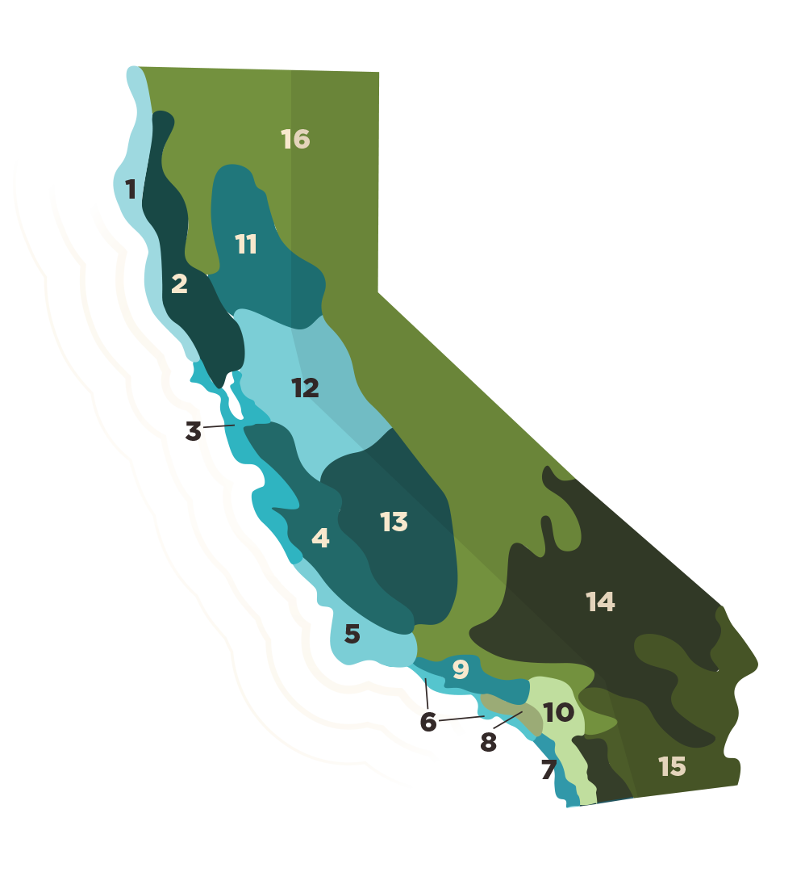
Contact Information
Bach Tsan P.E, Senior Mechanical Engineer
Phone: (916) 477-0834
Email: Bach.Tsan@Energy.ca.gov
Energy Code Hotline
Monday through Friday
8:00 a.m. to 12:00 p.m.
1:00 p.m. to 4:30 p.m.
Call
800-772-3300 in CA
916-654-5106 outside CA
Email
Title24@energy.ca.gov
47
Notes:
For any questions or comments related to the compliance manuals, please contact Bach Tsan or Payam Bozorgchami. Our contact information is shown on this slide.

Slide 48
Thank you

